Slide 1
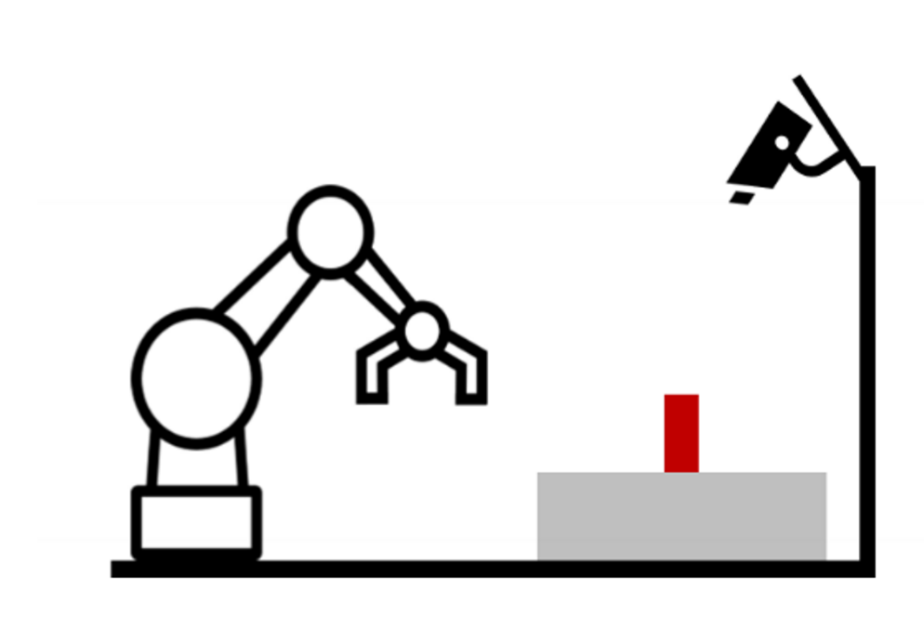










{B} : Base
{TCP} : Tool center point
{WS} : Work Space
{C} : Camera
{CB} : Checker board
$$\{C\}$$
$$\{TCP\}$$
$${}_{WS}^{C}T$$
$${}_{CB}^{C}T$$
$${}_{WS}^{TCP}T$$
$${}_{TCP}^{B}T$$
$$\{B\}$$
$$\{WS\}$$
$${}_{CB}^{WS}T$$
$$\{CB\}$$

Slide 2







Robot
$${}_{WS}^{B}T$$
$$WS_{origo}$$
$$WS_{y}$$
$${CB}_{origo}$$
$${CB}_{y}$$
Checkers
Board
$${CB}_{x}$$
$$WS_{x}$$

Slide 3

Robot
$${}_{WS}^{B}T$$
$$WS_{origo}$$
$$WS_{y}$$
$${}_{CB}^{WS}T$$
$${CB}_{origo}$$
$${CB}_{y}$$
Checkers
Board
$${CB}_{x}$$
$$WS_{x}$$

Slide 4





Robot
$${}_{WS}^{B}T$$
$$WS_{origo}$$
$$WS_{y}$$
$${}_{CB}^{WS}T$$
$${CB}_{origo}$$
$$2$$
$${CB}_{y}$$
Checkers
Board
$${}_{P}^{CB}T$$
$$B$$
$${CB}_{x}$$
$$WS_{x}$$

